Slide 1
Financial Statement Analysis and Management Accounting
Business Management for IT
(IT3090)
Lesson-4 (Part II)
Ms.Chalani Kuruppu
MLRHRM-UOC, BBA( Hons) in Business Management (UK)

Slide 2
Learning outcomes
Get an overall idea about the financial analysis
Classifications of financial ratios
-Profitability Ratios
-Liquidity Ratios
-Activity Ratios (Efficiency Ratios)
-Debt Ratios
Interpretation of ratio analysis.
Application of Target Costing

Slide 3
Financial Statements
Financial statements are the end product of the ‘Financial
Accounting’ process.
The objective of financial statements is,
Provide information about the financial position, performance
and changes in financial position of an entity that is useful to
a wide range of users in making economic decisions.

Slide 4
Financial Statement analysis
Financial analysis is the process of identifying the financial
strengths and weaknesses of a firm by properly establishing
relationship between the items in financial statements.
‘Financial Statement Analysis’ is a part of large information
processing system on which informed decisions can be based.
The type of analysis varies according to the specific interests
of the party involved.

Slide 5
Ratio Analysis
‘Ratio analysis’ is a study of various relationships between
different items reported in a set of financial statements.
Objective:
Ratios enable an analyst to make a comparison of a firm’s
financial condition over a time or in relation to other
firms.

Slide 6
Classification of Financial Ratios
Profitability Ratios
Liquidity Ratios
Activity Ratios (Efficiency Ratios)
Debt Ratios

Slide 7
PROFITABILITY RATIOS
Profitability ratios measure the results of business operations
or overall performance and effectiveness of the firm.
It evaluates a firm’s effectiveness in using its resources to generate profits.
Gross profit Rate
Net profit Rate

Slide 8
Gross profit Rate
Gross profit margin measures the percentage of each sales rupee remaining after the firm has paid for its goods.
The higher gross profit margin is better for the company.
Gross Profit Rate = Gross Profit x 100
Net revenue

Slide 9
Net Profit Rate
% of each sales rupee remaining after all costs and expenses deducted
Net Profit Rate = Net Profit x 100
Net Revenue

Slide 10
LIQUIDITY RATIOS
Liquidity of a firm is measured by its ability to satisfy its
short – term obligations as they come due.
These ratios can provide early signs of cash flow problems
and impending business failure.
Current Ratio
Quick (Acid – Test) Ratio

Slide 11
Current Ratio
Current ratio compares the company’s current assets with its
current liabilities.
The higher the current ratio, the more liquid the firm is
considered to be.
A current ratio of 2.0 is occasionally cited as acceptable
Current ratio = Current assets
Current liabilities

Slide 12
Quick (Acid – Test) Ratio
This ratio is similar to the current ratio except that it excludes
inventory, which is generally the least liquid current asset.
The quick ratio provides a better measure of overall liquidity only when
a firm’s inventory cannot be easily converted into cash.
A quick ratio of 1.0 or greater is occasionally recommended.
Quick ratio = Current assets – Inventory (Closing Stocks)
Current liabilities

Slide 13
ACTIVITY RATIOS
Activity ratio measures the how efficiently the
firm is using its assets.
Receivable days

Slide 14
Receivable days
This ratio measures the length of time it takes trade receivables to pay.
This also provides insight into the quality of the firm’s receivables and the firm’s efficiency in its collection.
The length of time taken to pay the dues represents a cost to a business .
(It’s like giving free credits).
Less time period is better for the business
Receivable days = Closing trade receivables x 365
Revenue

Slide 15
DEBT RATIOS
This ratio measures the debt position of a firm.
The more debt the firm has, the greater its risks of being unable to meet its contractual debt payments and becoming bankrupt.
Gearing Ratio

Slide 16
Gearing Ratio
This quantifies the relationships between debt and equity.
Debt includes loans, debentures, bonds and preference
Shares.
Higher proportion of debt indicates high risk.
Gearing Ratio = Debt x 100
Equity

Slide 17
Activity-1
Calculate the following ratios by using the given
financial statements and interpret them accordingly.
Gross profit rate
Net profit rate
Current ratio
Quick ratio
Receivable days
Gearing ratio

Slide 18
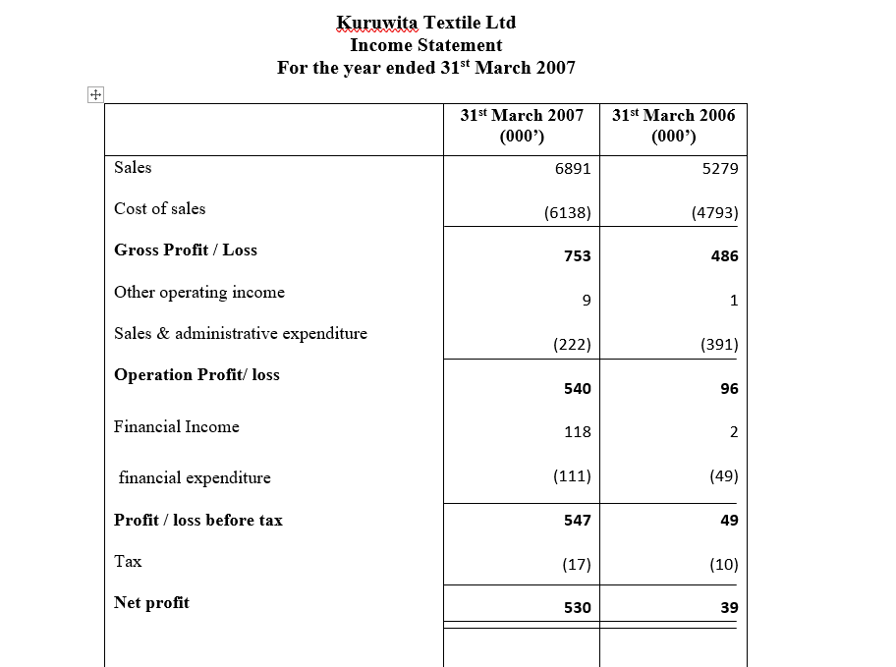

Slide 19
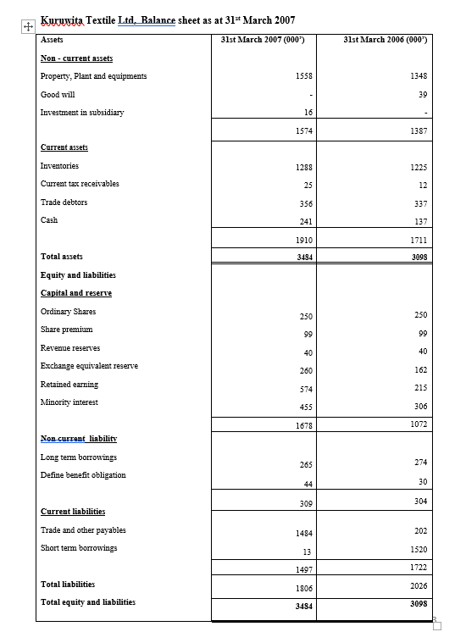

Slide 20
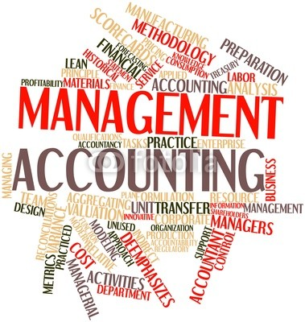
Management Accounting

Slide 21
Accounting Discipline Overview
Managerial Accounting – measures, analyzes and reports financial and nonfinancial information to help managers make decisions to fulfill organizational goals.
Financial Accounting – focus on reporting to external users including investors, creditors, and governmental agencies.

Slide 22

What is meant by ‘cost’?
Cost
System of computing cost of production or of running a business, by allocating expenditure to various stages of production or to different operations of a firm.
The amount of expenditure (actual or notional) incurred on or attributable to, a specified thing or activity. (CIMA Terminology)

Slide 23

Target costing
2
What is it?

Slide 24
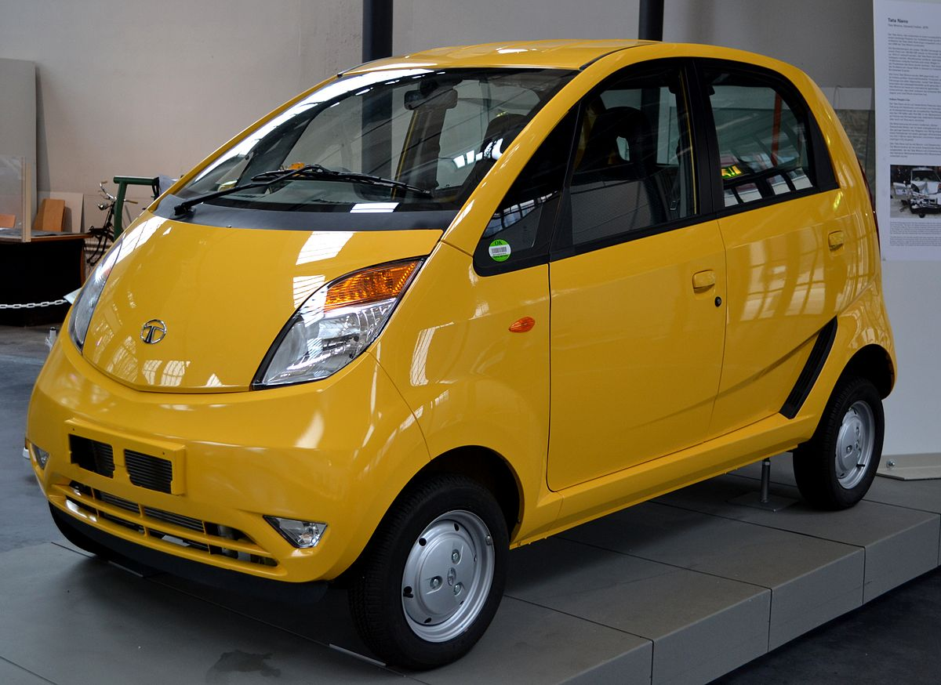
Let’s look at an example…

Slide 25
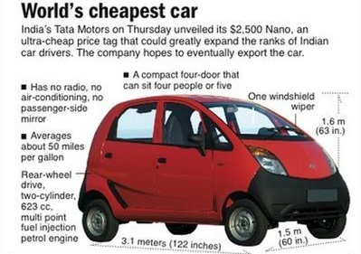
"people's car", the Tata Nano

Slide 26
A market driven costing system in which cost targets are set by considering customer requirements and competitive offerings
”

Slide 27
Steps in target costing
Determine customer wants and price sensitivity.
Planned selling price is set.
Target cost is determined as: Selling price – Desired profit
next slide

Slide 28
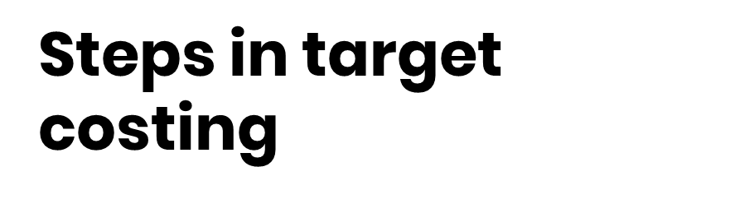
Teams of employees from various areas and trusted vendors simultaneously:
Design product
Determine manufacturing procedure
Determine necessary raw materials
Costs are considered throughout this process. The process requires trade-offs to meet target cost.
next slide

Slide 29
Once target cost is achieved, manufacturing begins and product is sold.
Sell

Slide 30
Activity-2
A company is planning a new product. Market research information suggests that the product should sell 10,000 units at $21.00/unit. The company seeks to make a mark-up of 40% product cost. It is estimated that the lifetime costs of the product will be as follows:
Design and development costs $50,000
Manufacturing costs $10/unit
End of life costs $20,000
The company estimates that if it were to spend an additional £15,000 on design, manufacturing costs/unit could be reduced.
Required (a) What is the target cost of the product? (b) What is the original lifecycle cost per unit and is the product worth making on that basis? (c) If the additional amount were spent on design, what is the maximum manufacturing cost per unit that could be tolerated if the company is to earn its required mark-up?

Slide 31

References
Horngren, C., Datar, S. and Rajan, M. (2012). Cost accounting: a managerial emphasis. 14th ed. New Jersey: Prentice Hall.

Slide 32
END

